Slide 1
龙净CV项目第六次汇报
汇报人：朱占宸
日期：2021.9.19

Slide 2
1. NH-HAZE: An Image Dehazing Benchmark with Non-Homogeneous Hazy and Haze-Free Images
Contribution: 引入了非均匀haze, 生成数据集
常用数据集
RESIDE | ITS(train) | 室内合成
 | SOTS(test) | 室内
 | HSTS(test) | 室外
I-HAZE |  | NTIRE18
O-HAZE |  | NTIRE18
DENSE-HAZE |  | NTIRE19
NH-Haze |  | NTIRE20
C. O. Ancuti, C. Ancuti and R. Timofte, "NH-HAZE: An Image Dehazing Benchmark with Non-Homogeneous Hazy and Haze-Free Images," 2020 IEEE/CVF Conference on Computer Vision and Pattern Recognition Workshops (CVPRW), 2020, pp. 1798-1805, doi: 10.1109/CVPRW50498.2020.00230.

Slide 3
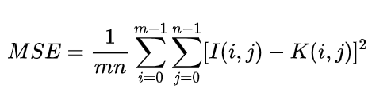
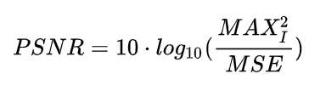
1. NH-HAZE: An Image Dehazing Benchmark with Non-Homogeneous Hazy and Haze-Free Images
评价标准
（1）PSNR(peak signal to noise ratio）
C. O. Ancuti, C. Ancuti and R. Timofte, "NH-HAZE: An Image Dehazing Benchmark with Non-Homogeneous Hazy and Haze-Free Images," 2020 IEEE/CVF Conference on Computer Vision and Pattern Recognition Workshops (CVPRW), 2020, pp. 1798-1805, doi: 10.1109/CVPRW50498.2020.00230.

Slide 4
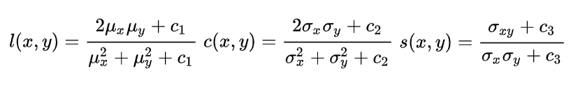
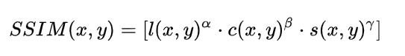
1. NH-HAZE: An Image Dehazing Benchmark with Non-Homogeneous Hazy and Haze-Free Images
评价标准
（1）SSIM(structure similarity)
C. O. Ancuti, C. Ancuti and R. Timofte, "NH-HAZE: An Image Dehazing Benchmark with Non-Homogeneous Hazy and Haze-Free Images," 2020 IEEE/CVF Conference on Computer Vision and Pattern Recognition Workshops (CVPRW), 2020, pp. 1798-1805, doi: 10.1109/CVPRW50498.2020.00230.

Slide 5
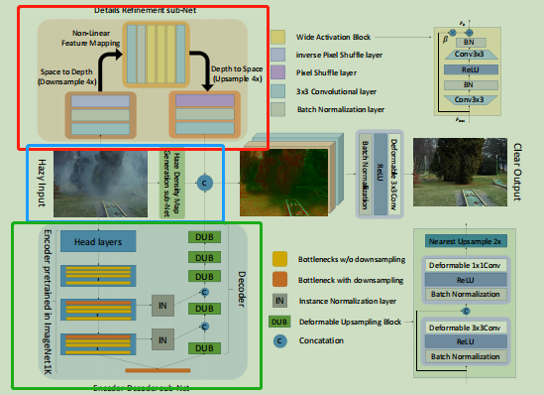
2. Trident Dehazing Network
Contribution：（1）引入新型FFT损失函数来监控频域信号
（2）提出TDN网络，实现雾霾密度自动识别
（3）在NTIRE2020去雾挑战中获得冠军
J. Liu, H. Wu, Y. Xie, Y. Qu and L. Ma, "Trident Dehazing Network," 2020 IEEE/CVF Conference on Computer Vision and Pattern Recognition Workshops (CVPRW), 2020, pp. 1732-1741, doi: 10.1109/CVPRW50498.2020.00223.

Slide 6
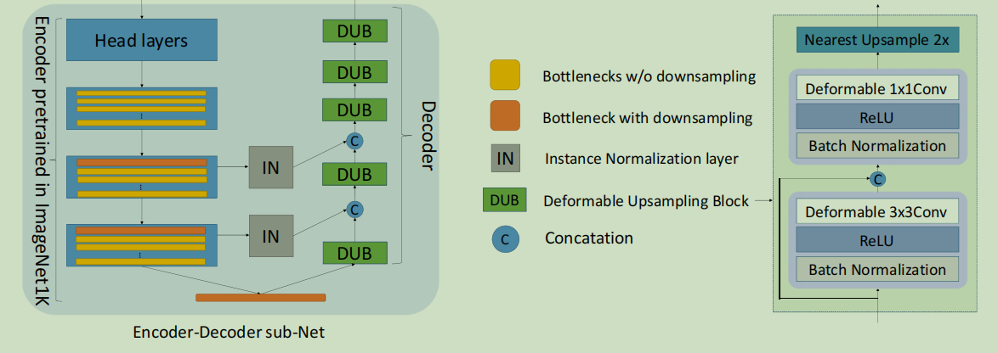
2. Trident Dehazing Network
Encoder‐Decoder sub‐Net（识别无雾粗特征）
（1）自编码器结构（2）浅层与深层特征拼接（3）DUB模块
J. Liu, H. Wu, Y. Xie, Y. Qu and L. Ma, "Trident Dehazing Network," 2020 IEEE/CVF Conference on Computer Vision and Pattern Recognition Workshops (CVPRW), 2020, pp. 1732-1741, doi: 10.1109/CVPRW50498.2020.00223.

Slide 7
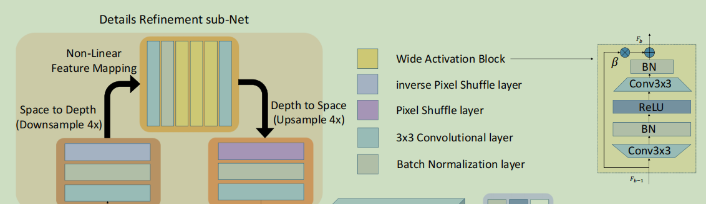
2. Trident Dehazing Network
Details Refinement sub-Net（识别无雾高频特征）
（1）亚像素卷积（Pixel shuffle）（2）WAB模块
Jiahui Yu, Yuchen Fan, Jianchao Yang, Ning Xu, Zhaowen Wang, Xinchao Wang, and Thomas Huang. Wide activa_x0002_tion for efficient and accurate image super-resolution. arXiv preprint arXiv:1808.08718, 2018.

Slide 8
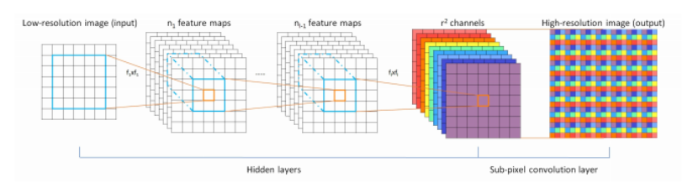
2. Trident Dehazing Network
Details Refinement sub-Net（识别无雾高频特征）
亚像素卷积（相较于转置卷积能捕获更多原图信息）
pytorch中有相关库函数可直接调用（pixel shuffle）
Wenzhe Shi, Jose Caballero, Ferenc Husz´ar, Johannes Totz, Andrew P Aitken, Rob Bishop, Daniel Rueckert, and Zehan Wang. Real-time single image and video super-resolution using an efficient sub-pixel convolutional neural network. In Proceedings of the IEEE conference on computer vision and pattern recognition, pages 1874–1883, 2016.

Slide 9
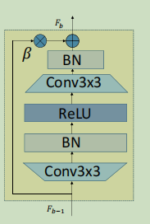
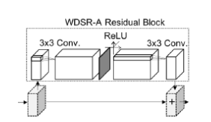
2. Trident Dehazing Network
Details Refinement sub-Net（识别无雾高频特征）
Wide Activation Block(扩展ReLU前的特征)
Jiahui Yu, Yuchen Fan, Jianchao Yang, Ning Xu, Zhaowen Wang, Xinchao Wang, and Thomas Huang. Wide activation for efficient and accurate image super-resolution. arXivpreprint arXiv:1808.08718, 2018.

Slide 10
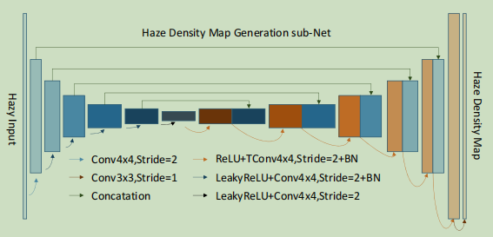
2. Trident Dehazing Network
Haze Density Map Generation sub-Net（生成雾浓度密度图）
Phillip Isola, Jun-Yan Zhu, Tinghui Zhou, and Alexei A Efros. Image-to-image translation with conditional adversarial net_x0002_works. In Proceedings of the IEEE conference on computer vision and pattern recognition, pages 1125–1134, 2017.

Slide 11
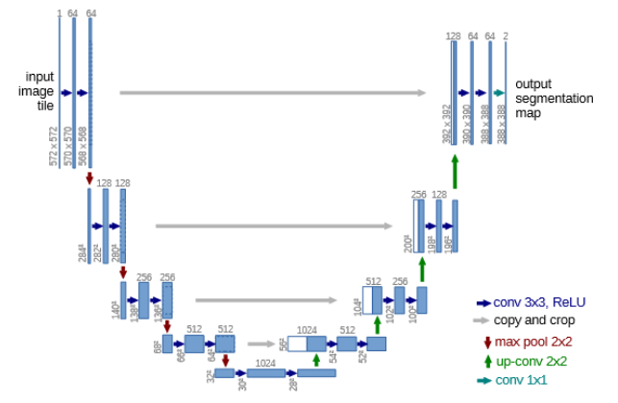
2. Trident Dehazing Network
Haze Density Map Generation sub-Net（生成雾浓度密度图）
u-Net(多用于医学图像分割)
下采样部分：提取图片特征
上采样部分：定位特征
skip connection：将各个阶段信息进行整合
Phillip Isola, Jun-Yan Zhu, Tinghui Zhou, and Alexei A Efros. Image-to-image translation with conditional adversarial net_x0002_works. In Proceedings of the IEEE conference on computer vision and pattern recognition, pages 1125–1134, 2017.

Slide 12
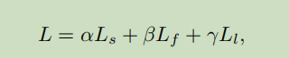
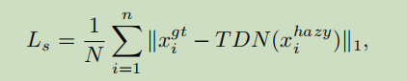
2. Trident Dehazing Network
损失函数：（1）空间域损失
（2）频率域损失
（3）阈值限制损失
（1）Spatial Domain Loss
J. Liu, H. Wu, Y. Xie, Y. Qu and L. Ma, "Trident Dehazing Network," 2020 IEEE/CVF Conference on Computer Vision and Pattern Recognition Workshops (CVPRW), 2020, pp. 1732-1741, doi: 10.1109/CVPRW50498.2020.00223.

Slide 13
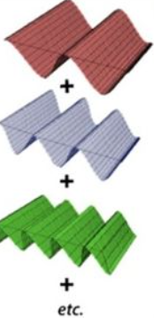
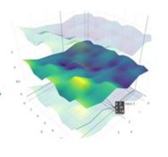
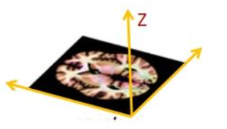
2. Trident Dehazing Network
（2）Frequency Domain Loss（傅里叶变换）
任意波==很多正弦波合成
任意曲边==很多正弦平面波合成
Z轴为灰度值大小
J. Liu, H. Wu, Y. Xie, Y. Qu and L. Ma, "Trident Dehazing Network," 2020 IEEE/CVF Conference on Computer Vision and Pattern Recognition Workshops (CVPRW), 2020, pp. 1732-1741, doi: 10.1109/CVPRW50498.2020.00223.

Slide 14
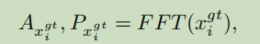
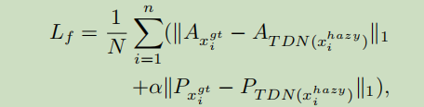
2. Trident Dehazing Network
（2）Frequency Domain Loss）
清晰图片的幅值与相位
生成图片的幅值与相位
L1损失
J. Liu, H. Wu, Y. Xie, Y. Qu and L. Ma, "Trident Dehazing Network," 2020 IEEE/CVF Conference on Computer Vision and Pattern Recognition Workshops (CVPRW), 2020, pp. 1732-1741, doi: 10.1109/CVPRW50498.2020.00223.

Slide 15
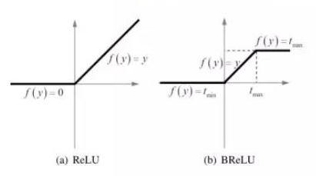
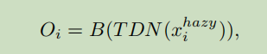
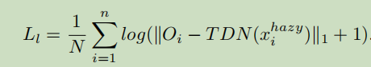
2. Trident Dehazing Network
（3）阈值限制损失
双边整流线性单元（BReLU）
Bolun Cai, Xiangmin Xu, Kui Jia, Chunmei Qing, and Dacheng Tao. Dehazenet: An end-to-end system for single image haze removal. IEEE Transactions on Image Processing, 25(11):5187–5198, 2016.

Slide 16
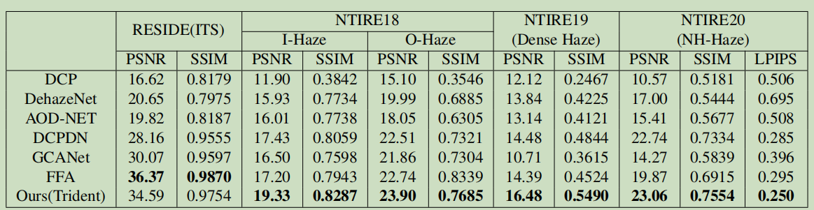
2. Trident Dehazing Network
实验数据集与评价标准
J. Liu, H. Wu, Y. Xie, Y. Qu and L. Ma, "Trident Dehazing Network," 2020 IEEE/CVF Conference on Computer Vision and Pattern Recognition Workshops (CVPRW), 2020, pp. 1732-1741, doi: 10.1109/CVPRW50498.2020.00223.

Slide 17
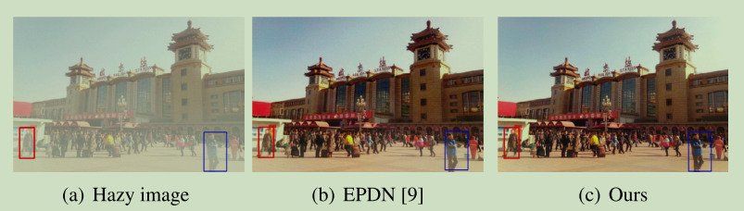
3. Haze concentration adaptive network for image dehazing
Contribution：解决烟雾残留问题
其他论文缺点：（1）未用CNN中高中低层特征
（2）在浅雾中适用，浓雾不适用
Tao Wang, Li Zhao, Pengcheng Huang, Xiaoqin Zhang, Jiawei Xu, Haze concentration adaptive network for image dehazing,
Neurocomputing,Volume 439, 2021Pages 75-85, ISSN 0925-2312,

Slide 18
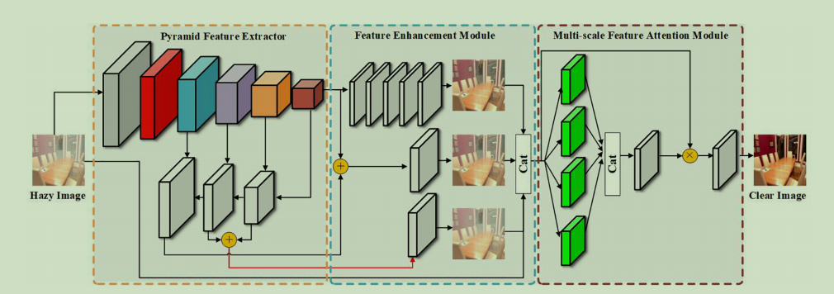
3. Haze concentration adaptive network for image dehazing
HCAN网络结构： a Pyramid Feature Extractor(PFE)
a Feature Enhancement module (FEM)
a Multi-scale Feature Attention module (MSFAM)
Feature Attention module (MSFAM).
Tao Wang, Li Zhao, Pengcheng Huang, Xiaoqin Zhang, Jiawei Xu, Haze concentration adaptive network for image dehazing,
Neurocomputing,Volume 439, 2021Pages 75-85, ISSN 0925-2312,

Slide 19
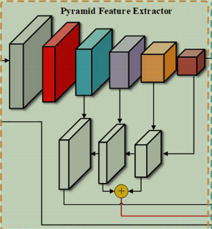
3. Haze concentration adaptive network for image dehazing
a Pyramid Feature Extractor(PFE)
6层卷积层提取特征，
并将特征划分为高中低三类特征
Tao Wang, Li Zhao, Pengcheng Huang, Xiaoqin Zhang, Jiawei Xu, Haze concentration adaptive network for image dehazing,
Neurocomputing,Volume 439, 2021Pages 75-85, ISSN 0925-2312,

Slide 20
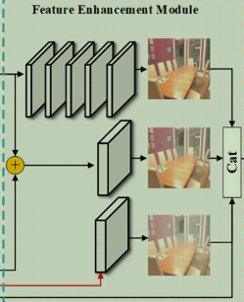
3. Haze concentration adaptive network for image dehazing
a Feature Enhancement module (FEM)
（1）将三类特征分别进行去雾操作，
可得到去雾程度不同的还原图片
（2）将三幅图片与原先的重雾图片拼接
Tao Wang, Li Zhao, Pengcheng Huang, Xiaoqin Zhang, Jiawei Xu, Haze concentration adaptive network for image dehazing,
Neurocomputing,Volume 439, 2021Pages 75-85, ISSN 0925-2312,

Slide 21
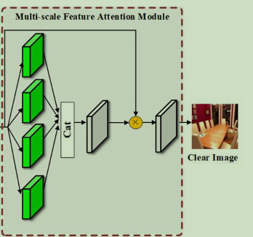
3. Haze concentration adaptive network for image dehazing
a Multi-scale Feature Attention module (MSFAM)
使用 1，3，5，7不同尺寸的卷积核提取特征
Tao Wang, Li Zhao, Pengcheng Huang, Xiaoqin Zhang, Jiawei Xu, Haze concentration adaptive network for image dehazing,
Neurocomputing,Volume 439, 2021Pages 75-85, ISSN 0925-2312,

Slide 22
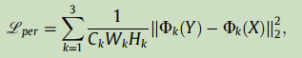
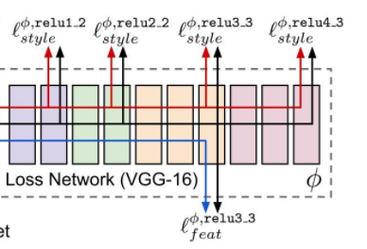
3. Haze concentration adaptive network for image dehazing
Perceptual loss
Tao Wang, Li Zhao, Pengcheng Huang, Xiaoqin Zhang, Jiawei Xu, Haze concentration adaptive network for image dehazing,
Neurocomputing,Volume 439, 2021Pages 75-85, ISSN 0925-2312,

Slide 23
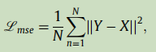
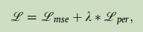
3. Haze concentration adaptive network for image dehazing
损失函数
MSE
Perceptual loss
Total loss
Tao Wang, Li Zhao, Pengcheng Huang, Xiaoqin Zhang, Jiawei Xu, Haze concentration adaptive network for image dehazing,
Neurocomputing,Volume 439, 2021Pages 75-85, ISSN 0925-2312,

Slide 24
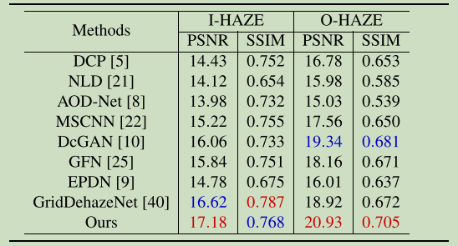
3. Haze concentration adaptive network for image dehazing
实验数据
Tao Wang, Li Zhao, Pengcheng Huang, Xiaoqin Zhang, Jiawei Xu, Haze concentration adaptive network for image dehazing,
Neurocomputing,Volume 439, 2021Pages 75-85, ISSN 0925-2312,

Slide 25
感谢聆听！

